Slide 1

Git and Github introduction
Sebastião Jerónimo

Slide 2
What is git and github?
Git is a version controller, it controls all the changes in your code! If you make a mistake you can go back to a previous version of your code before the mistake!
Github stores your code and all the changes that were made to it! Github is a website that stores all the code so you can collaborate on it with multiple people at the same time using git!

Slide 3
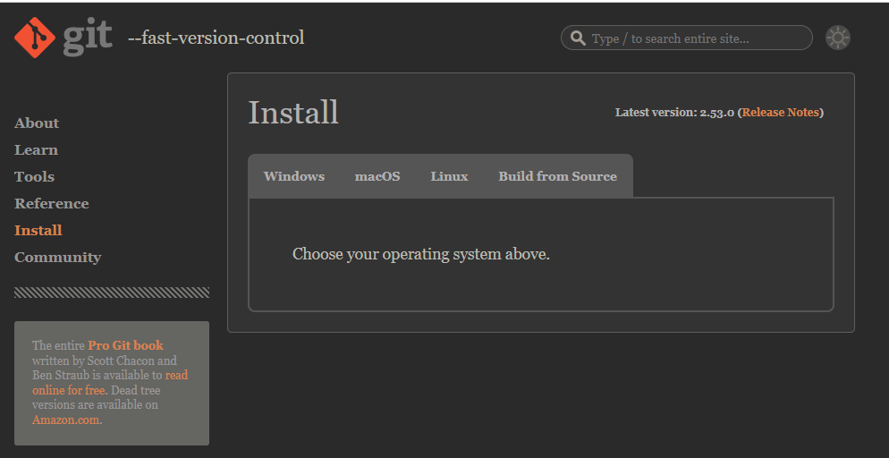

How do I install and setup git?
Install it it's free! I will leave the link in the comments -> https://git-scm.com/install/

Slide 4

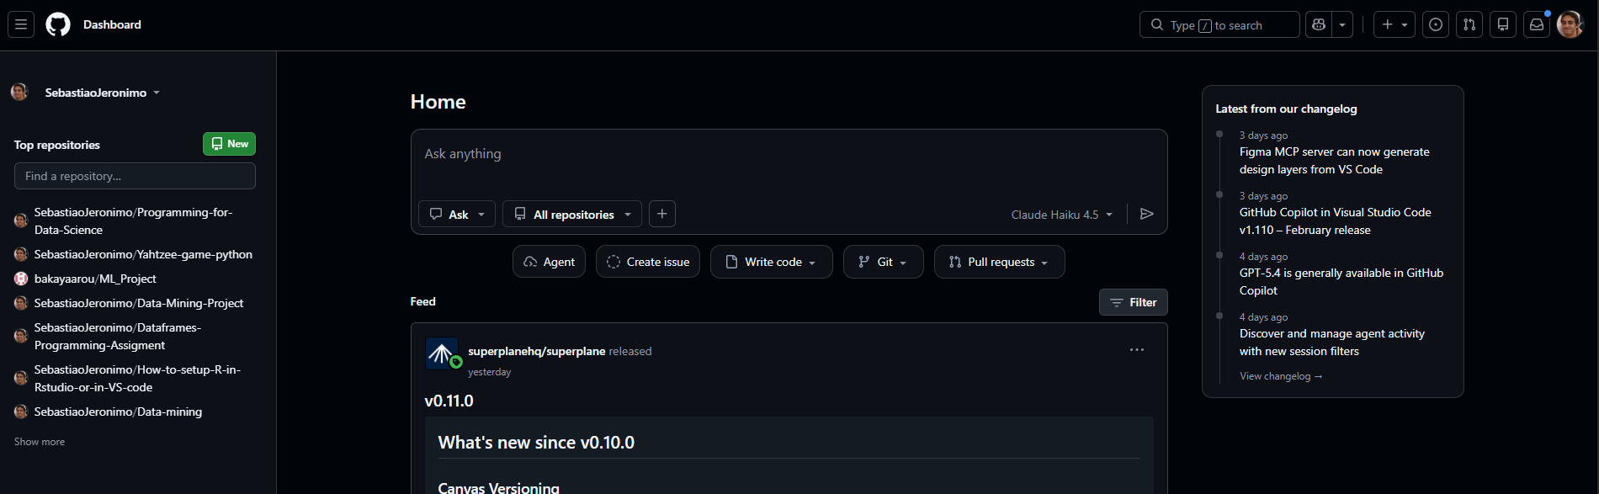
How do I setup github?
To use github you can just create an account its free!
The link will also be in the comments -> https://github.com/

Slide 5
Lets create a repository
After having git installed (confirm with git --version)
And created a github account
Lets create a github repository!
But what is a repository? A repository it's just a place to store our code so we can work with it using git , this is much better than working locally because we can store our code revert mistakes and work with others at the same time!

Slide 6
Using git commands for the first time
git clone Bringing the project from the github repository to your computer.
git add <specific file> Choosing the changes that you want to do to the code.
git commit -m “note” Confirming the changes with a note.
git push Sending the code with your updated changes to the github repository.
Resolving conflicts
git pull When you don't have the last version you can pull the changes that you are missing.

Slide 7
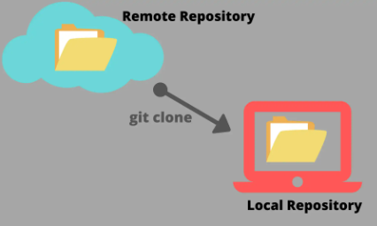
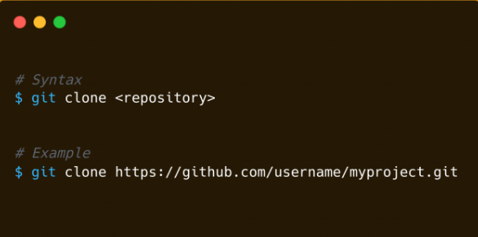
Git clone
Cloning a repository is getting the files that are stored on the github repository (location in the cloud) to your computer.

Slide 8





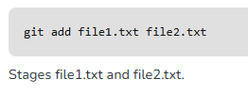


Git Add
We can use the git add to choose the changes that we want to add to the repository.
-A

Slide 9

Git Commit
We use git commit to confirm the changes we want to add to the repository
When we commit to the repository we must add a note. ( -m <message>)
Syntax:
Message example:

Slide 10
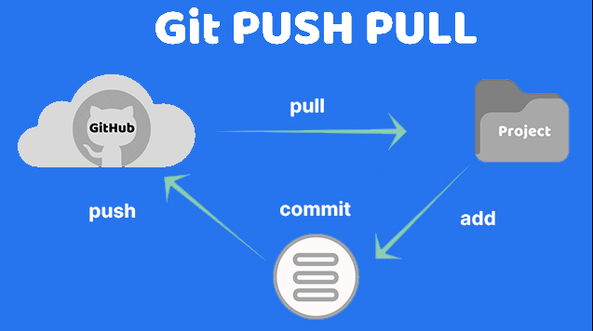

Git Push
After confirming the changes with git commit we will send the changes to the repository with git push.
Syntax:

Slide 11
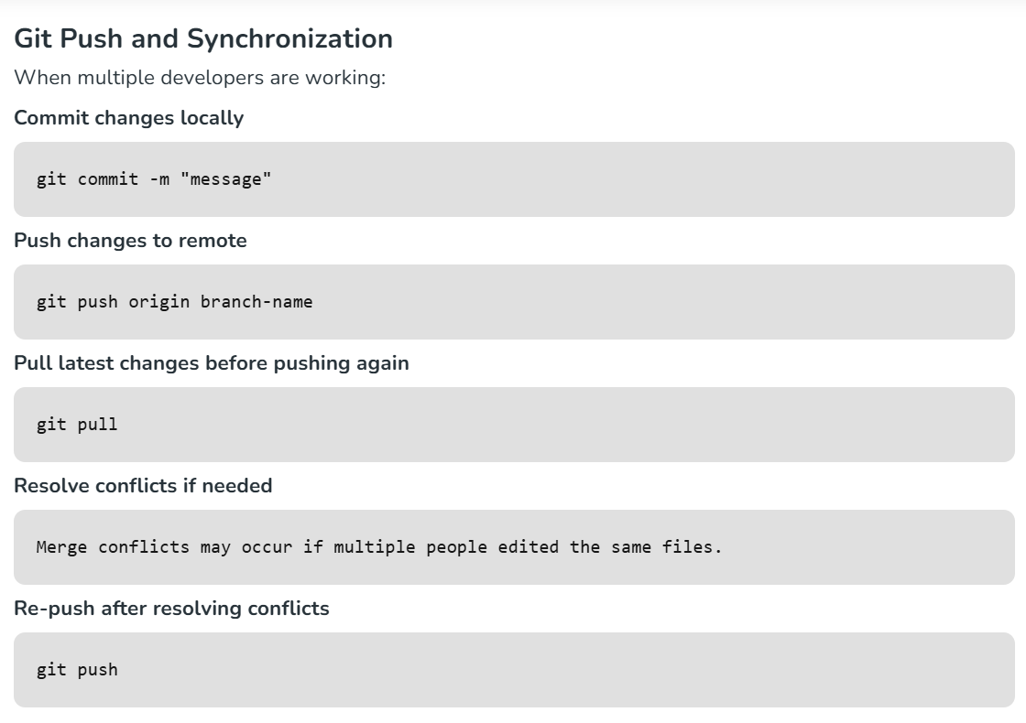
Resolving conflicts with Git Pull
Before pushing you have to pull the latest changes if you don't have the updated version
Syntax: Git pull

